Slide 1

Welcome to our Presentation
Data Visualization Associate Internship
Team 40
Team Members as Presentors :
Sumaiya Tasnim – Project Scribe – sumaiyaa.tasnim.18@gmail.com
Huzaifa Tariq – Project Manager – huzaifatariq757@gmail.com

Slide 2
Objectives
Week-1 : Set up ‘PostGreSQL’, Importing Datasets, Performing Exploratory Data Analysis & Visualizations
Week-2: Master Table Creation, ETL process(Data Cleaning), Data Quality Verification
Week-3: Mapping Table Creation, Identification of Key Metrics, KPIs, Applied Business Logic, Designing Wireframe using ‘Figma’
Week-4: Connection of Database To Looker Studio, Final Dashboard Design & Creation, Visual Storytelling, Final Presentation

Slide 3

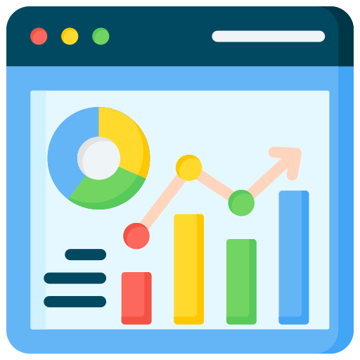
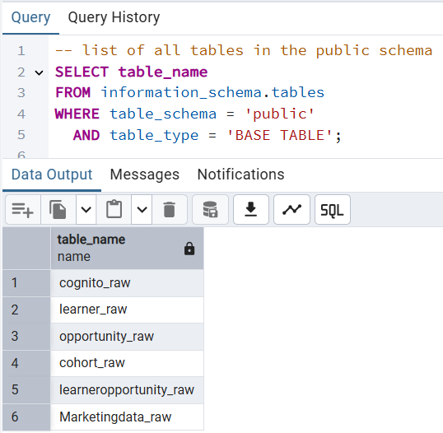
Setup Of PostGreSQL, Imported Assigned Datasets
Performed Data Visualizations of each Datasets
Performed Data Analysis
of each Datasets
Recognition of Datatypes
Checking of Total Records & Columns
Verifying of Duplicate Values
Null /Missing Values Detection
Inconsistent Data Entries

Slide 4
Assigned Datasets
03
04
05
06
01
02
User_data.csv
Opportunity_Raw.csv
Learner_Opportunity_Raw.csv
Cognito_Raw.csv
Cohort_Raw.csv
Marketing_data.csv
(Not Connected To Master Table- Standalone)
Master Table

Slide 5
Master Table
Extract, Transformation & Load
(ETL Process)
Conversion of all Column’s correct Datatypes
Ensured join keys exist for Relationships
Missing/NULL values were replaced with “Unknown” value
URLs/inconsistent entries were replaced with “Unknown” value
Duplicate Records were detected & removed

Slide 6
Cleaned Master Table
Mapping Table Walkthrough
Identified
Key Performance Indicator (KPIs)
Metrics (Formulas)
Filters & Drill-Down Controls
WireFrame Creation - A draft of Dashboard

Slide 7
Mapping Table Concept
(Chosen the Priority ones)
Required And Included Dashboard Charts
Bar Chart
Chart Name: Applications per Opportunity
Row Chart
Chart Name: Total Applications of Each Country
Donut Chart
Chart Name: Unique Learners per Opportunity Category Pie Chart
Chart Name: Distribution of Application by Gender Donut Chart
Chart Name: Status by Email Line Chart
Chart Name: Cohort Enrollment Over Time Heatmap
Chart Name: Enrollment Rate by Country vs. Opportunity Category
KPI: Total Applications
Filter: Opportunity Category
Purpose: Measure overall application volume
KPI: Remaining Seats
Filter: Date Range
Purpose: Monitor available capacity and prevent overflow
KPI: Unique Learners
Filter: Status
Purpose: Track individual applicants and avoid duplicates
KPI: Enrollment Rate
Filter: Gender
Purpose: Evaluate conversion from applications to enrollments
KPI: Cohort Capacity
Filter: Country
Purpose: Understand total seats available per cohort
KPI: Application Velocity
Filter: Learner ID
Purpose: Measure speed of incoming applications

Slide 8
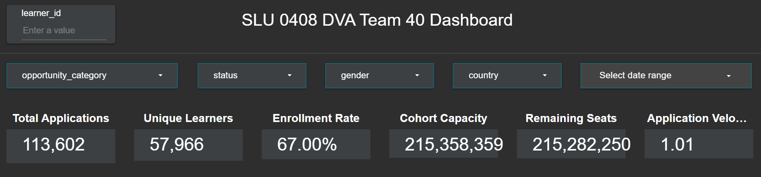
Viewing The Master Table’s Dashboard in Looker Studio (Step By Step)
Filters & KPIs In Dashboard
Filters & KPIs Purpose in Dashboard:
Enable focused analysis by category, status, gender, country, and date. Track key performance metrics like applications, enrollments, and remaining seats. Support trend monitoring and conversion insights. Facilitate quick decision-making and resource planning.

Slide 9
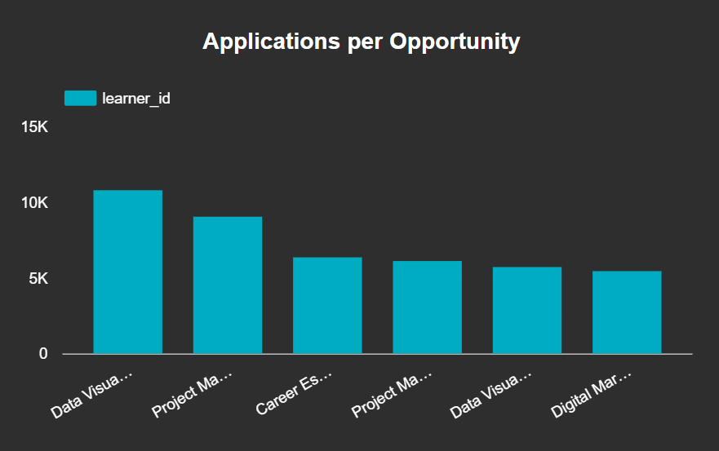
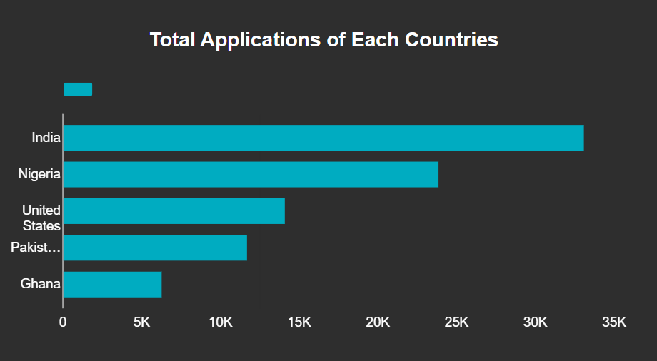
Bar Chart Visualization
Row (Horizontal) Chart Visualization
PURPOSE:
Shows application volume by country. Highlights geographic trends. Supports regional strategy.
PURPOSE:
Shows demand per opportunity.
Compares opportunities quickly.
Guides resource planning.

Slide 10
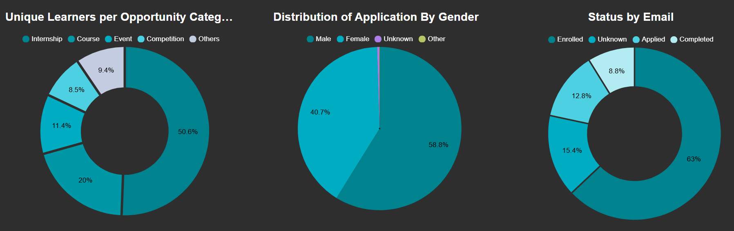
Pie & Donut Chart Visualization
PURPOSE:
Highlights learner diversity, avoids duplicate counts.
PURPOSE:
Shows demographic split of applicants.
PURPOSE:
Tracks learners by application stage.

Slide 11
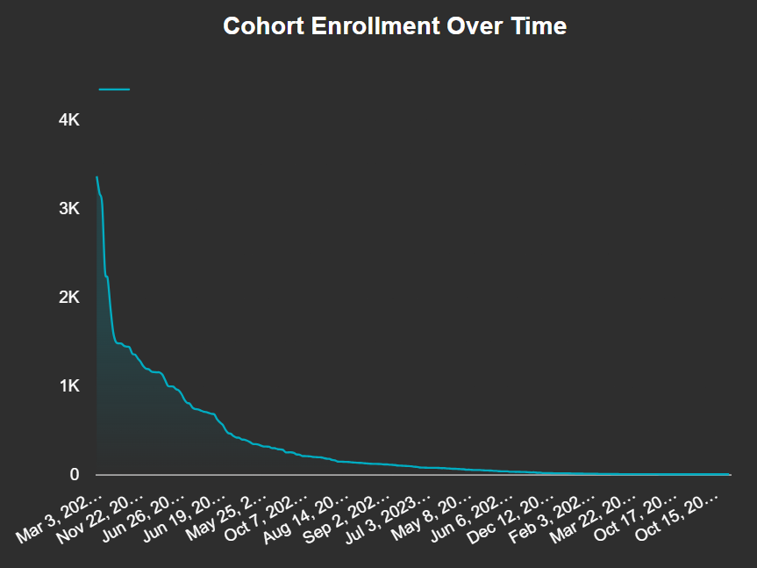
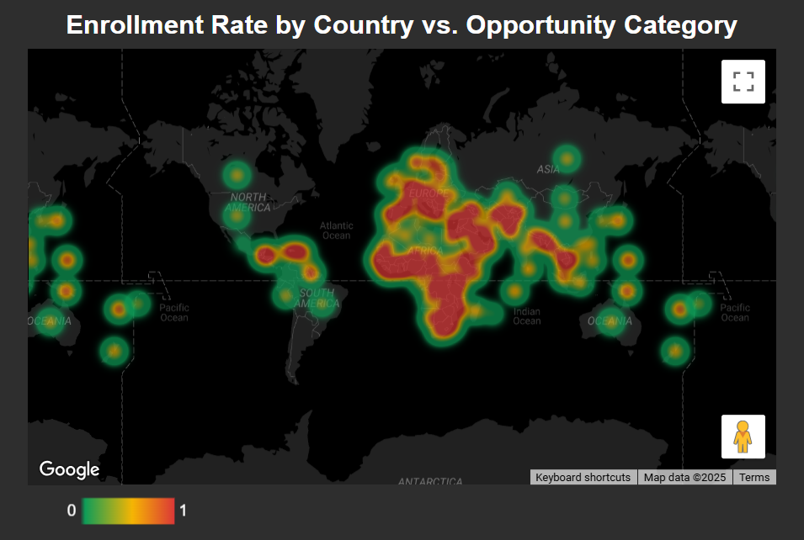
Line Chart Visualization
Heatmap Chart Visualization
PURPOSE:
Shows enrollment efficiency by region and category. Identifies strong and weak areas.
Guides targeted improvements.
PURPOSE:
Tracks enrollment growth across cohorts. Monitors conversion trends over time. Helps evaluate program effectiveness.

Slide 12
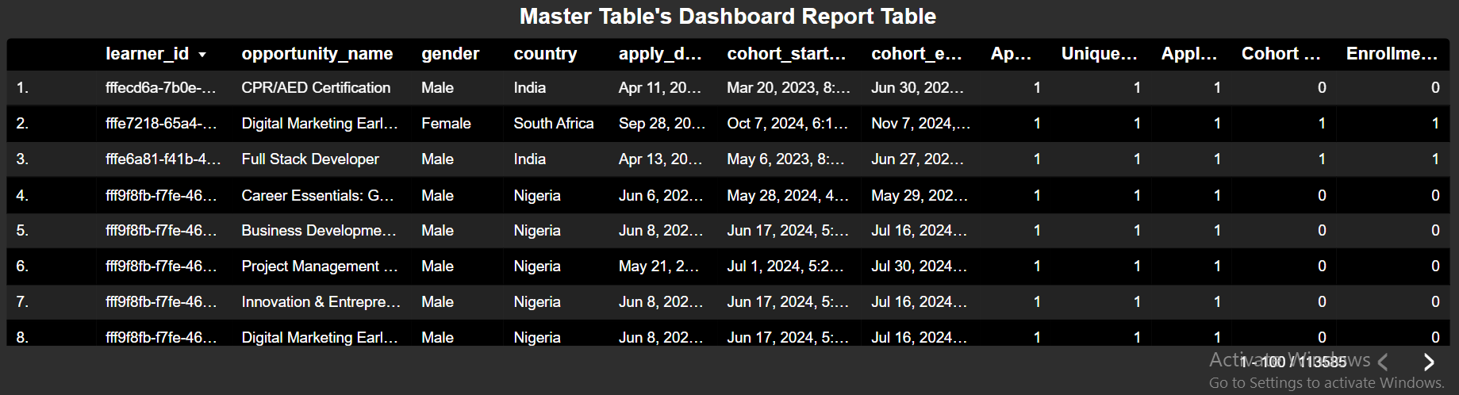
Dashboard Report Table
Purpose of Adding a Table Report in Dashboard: Provides detailed, row-level data for deeper analysis. Allows easy comparison of multiple metrics side by side. Supports data validation and quick reference for decision-making.

Slide 13
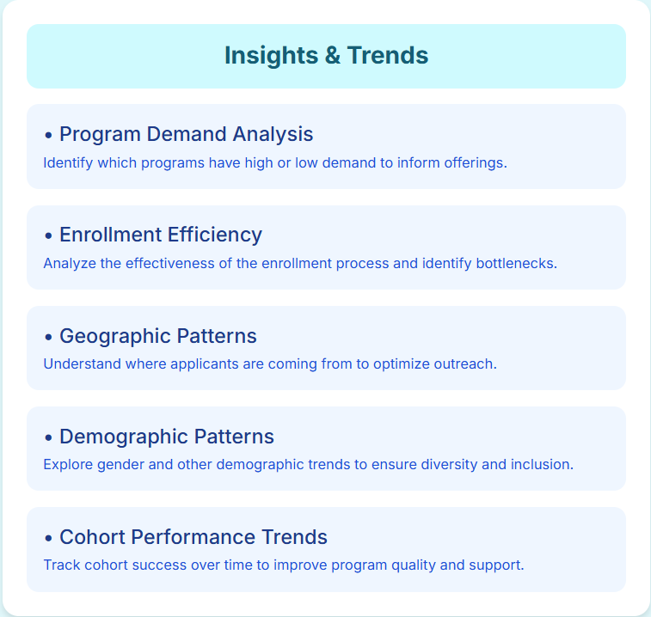
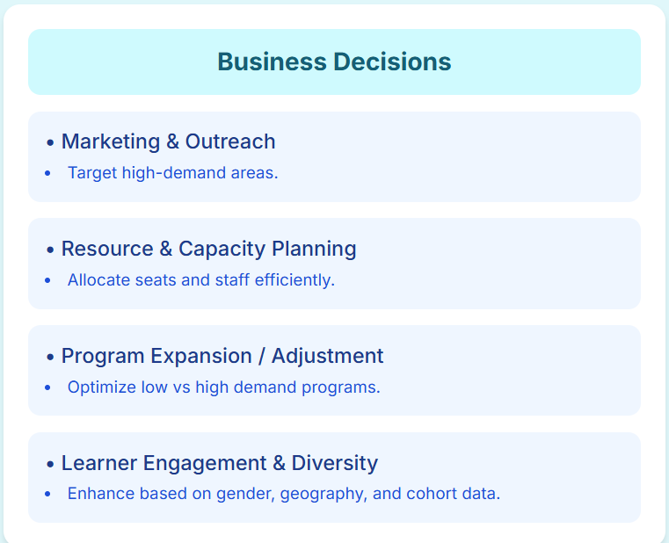
From Insights to Business Action

Slide 14
Conclusion
Finally, the dashboard is ready, offering clear insights on applications, enrollments, learner demographics, and cohort performance for informed decisions. As a team, we collaborated effectively and enhanced our skills in Data analysis, Data visualizations,KPI & Metrics tracking and lastly building up a cleared Visual Dashboard.
Link Of Access Dashboard Report in Looker Studio: https://lookerstudio.google.com/reporting/f5cee034-e374-4f6f-b313-264f8b375e4d

Slide 15



Thank you
Data Visualization Associate Internship Feedback:
We Gained advanced skills in data visualization and analysis, including master table creation, KPI and metric mapping, filter and drill-down implementation, and developing a comprehensive visual dashboard.
Thanks to the team & all associates for their guidance and support.

